Slide 1
Rapid Web App Dev in Spring Boot
Maciej Garbacz

Slide 2
Table of contents:
What and why of Spring Boot
Spring Initializr + REST API = Hello World
A Time-logging application (JDBC, Spring Profiles, H2 DB)
Future of Spring Boot and conclusions

Slide 3
Code available at:
https://github.com/MacGarbacz/workshop.git

Slide 4
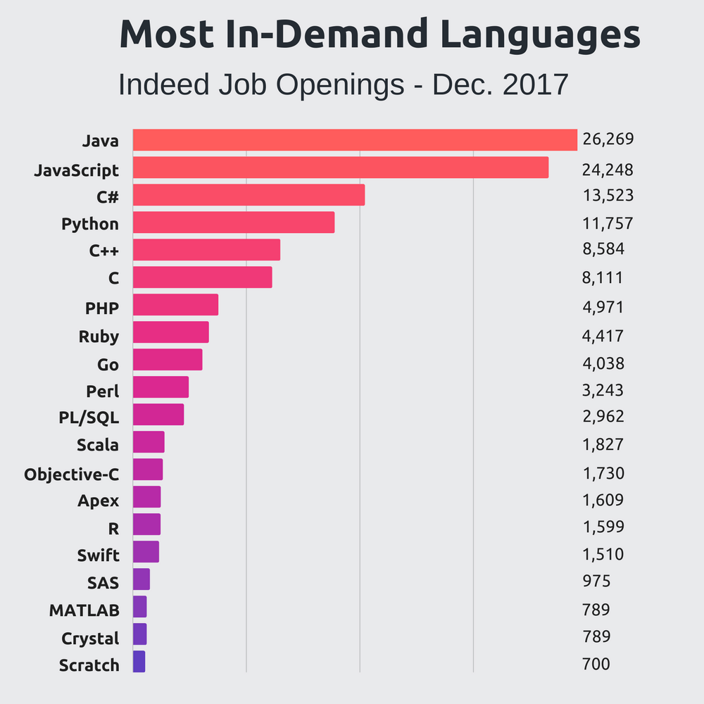
What is Spring?
Framework for enterprise grade Java applications
Inversion of control (IoC) container
Original release - 2002
Image source: https://stackify.com/popular-programming-languages-2018/

Slide 5
What is Spring Boot and why use it?
Spring Boot makes it easy to create stand-alone, production-grade Spring based Applications that you can "just run".[1]
Enables rapid creation of stand alone applications
Features an embedded Tomcat
No initial configuration/XML required
Convention over configuration
Opinionated view of configuration

Slide 6
Demo 1
Spring Initializr
REST API

Slide 7
Demo 2
H2 DB
JDBC templates
Spring Profiles
Scheduling
Actuator

Slide 8
Future of Spring and Spring Boot
Support for next versions of Spring -> currently 5.0
“Milestone” releases e.g. 2.1.1
Support for third-party library updates
Increased emphasis on security and monitoring
Cloud support
Emphasis on microservices

Slide 9
Questions?

